Slide 1


The University of Akron
DataDotZip

Slide 2
Agenda
Provide analysis of purchasers grouped by behaviors
Answer behaviors indicative to subsequent purchases
Accurately define how to drive cart value
Offer recommendations based on data findings

Slide 3
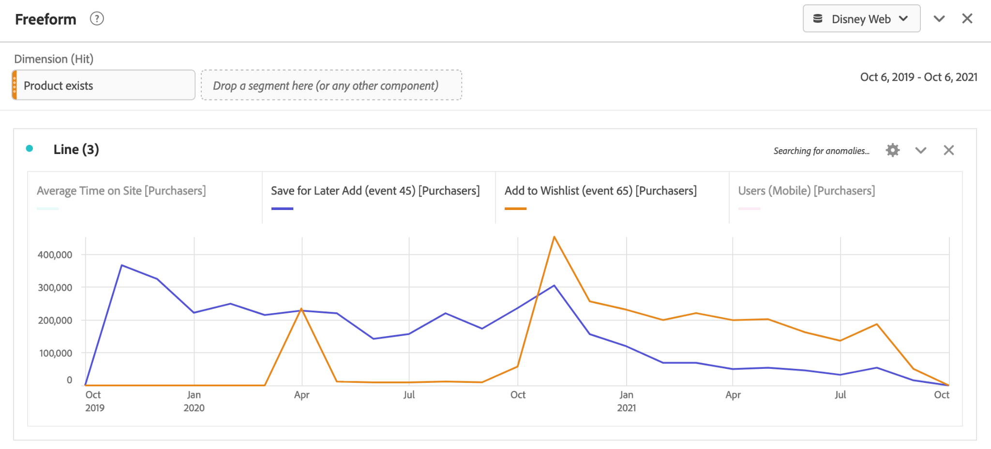
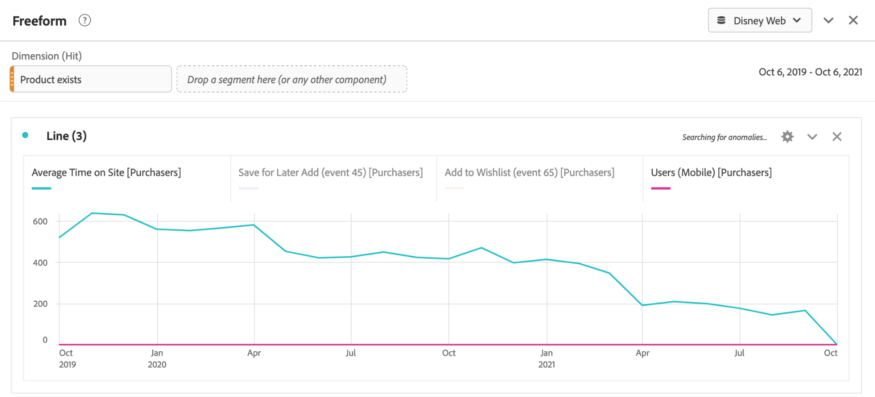
Purchasers Grouped
By Behavior
Notes:
In order to find out purchasing behavior prior to purchase, we filtered the purchasers segment by 4 metrics as shown in following slides:
Average time on site
Save for later add (event 45)
Add to wishlist (event 45)
Users (Mobile)
As per the above graph, generally customers who save items for a later time (blue) are more likely to purchase the item, but this trend seems to be decreasing over the last year.
Also, it can be seen that people who generally Add to wishlist (Yellow) between April to May and October to December (Disney Web) are highly likely to purchase, which shows that consumers are highly likely to purchase during vacations time.
Average time on site before 2 years was more indicative that those users would end up being purchasers, but that correlation diminished over the last year and it is not one of the prominent behaviors of purchasers anymore.
Correlation between people who are mobile users and who end up becoming purchasers is zero in past 2 years.
So, according to the above analysis seasonality plays a huge role in purchasers’ buying behavior because people are more likely to buy during their children's’ holidays.

Slide 4
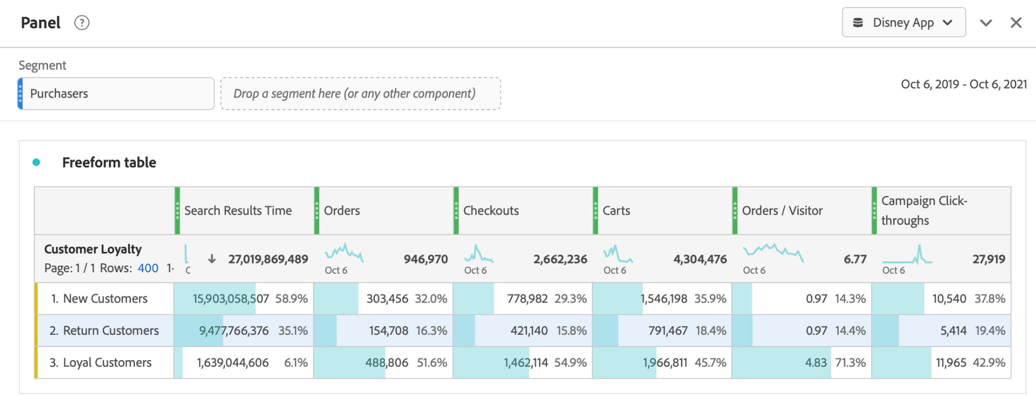
Subsequent Purchase Behaviors
Notes:
The next couple slides are showing the correlation between Customers Loyalty within the Disney App and different metrics that helps answer the question, what are the differences in buying patterns between New/Return and Loyal Customers. The range for each of the different types of customers are very different, which is why we decided to one; start out with showing the table comparing all and two; split up the graphs to get a better understanding of what is going on. The Table above is a key component to analyzing this question, due to easily being able to understand the numbers and knowing which metric is greater or lower for each Customer Loyalty type.

Slide 5
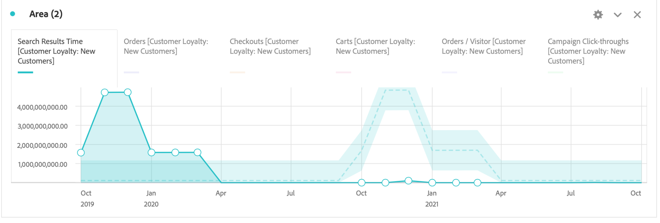
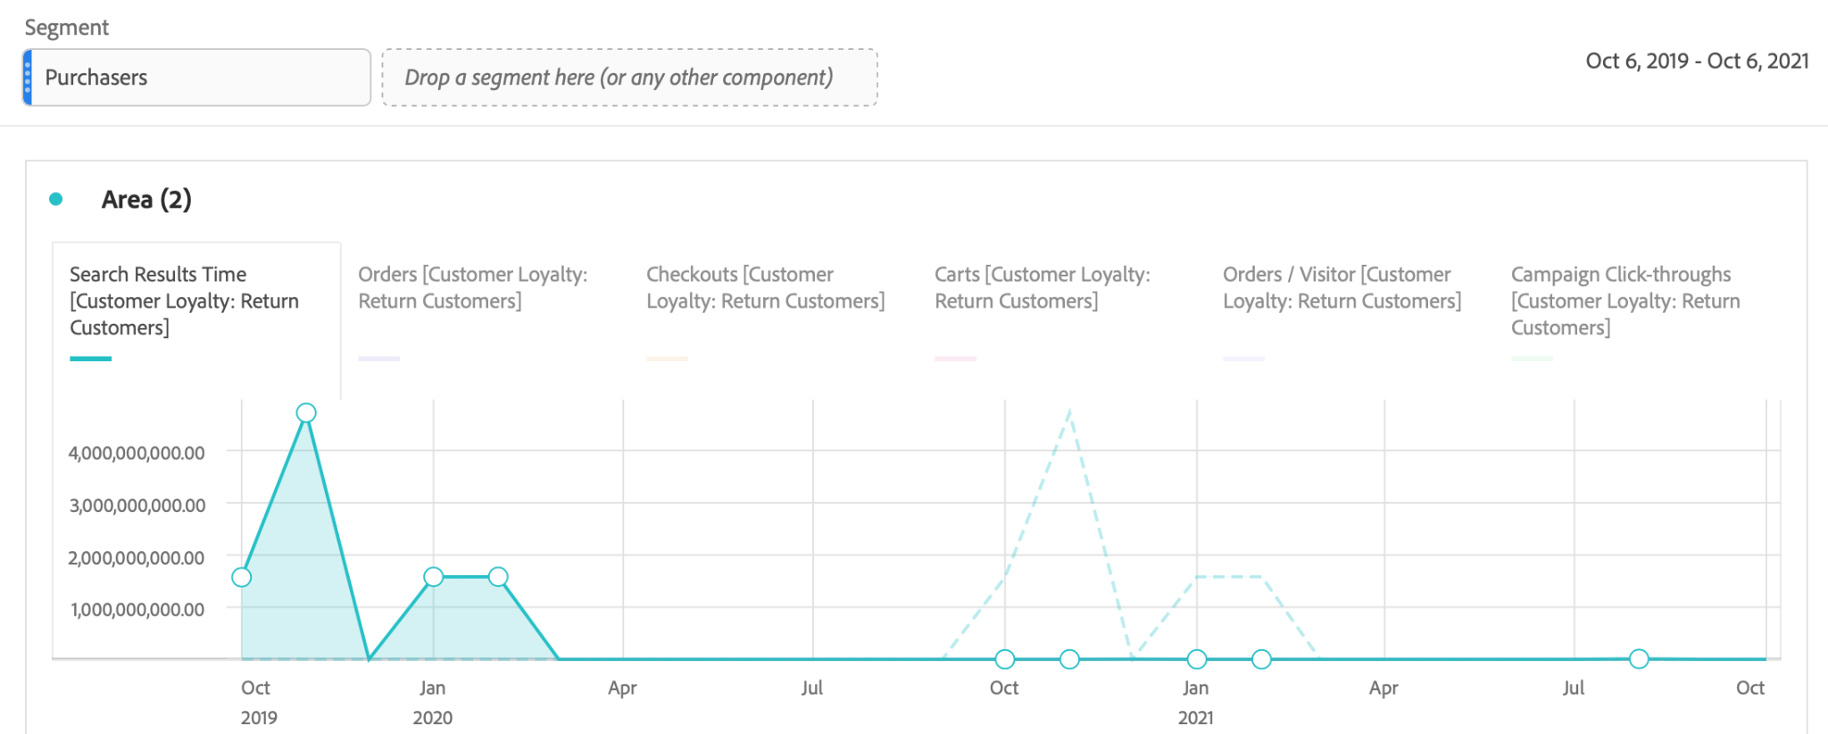
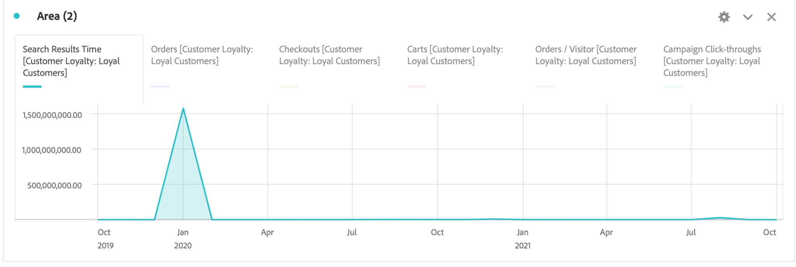
Notes:
To start off, the graphs above are showing Customer vs. Search Time per month. It is important to look at Search Time because the less time customers are searching the more efficient they are being and more likely to buy. Looking at the graphs, New Customers search time is the greatest and Loyal Customers is the least. Which means that Loyal Customers tend to know exactly what they want and don’t need to search around for it. Since New Customers don’t know exactly what they want when they get on the site, it would be important to focus on advertising different products, so when customers see that product they will go straight to it and spend less time searching.

Slide 6
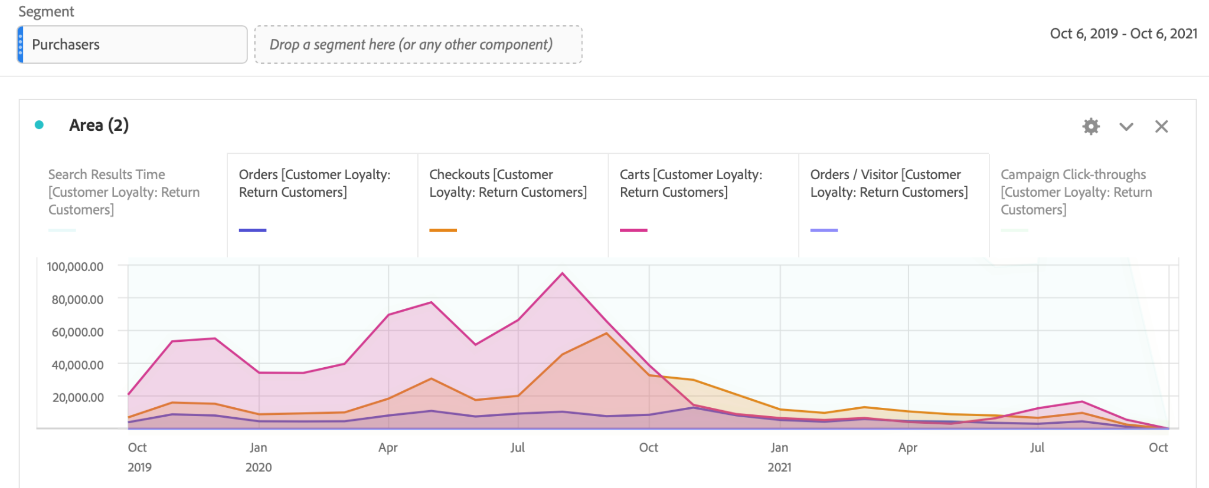
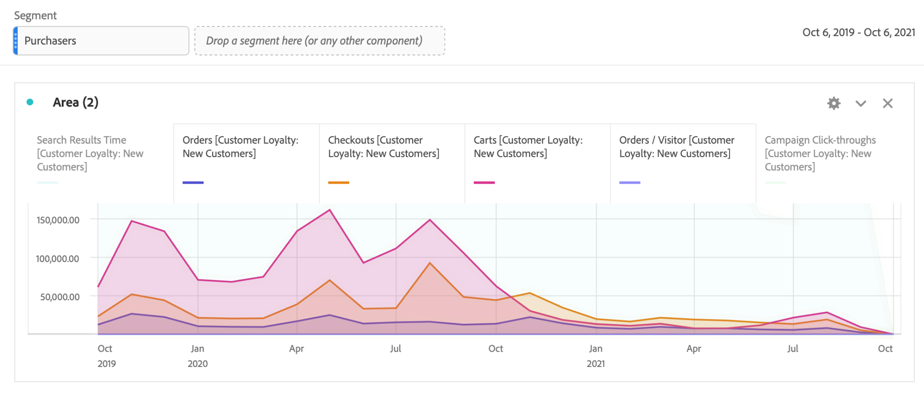
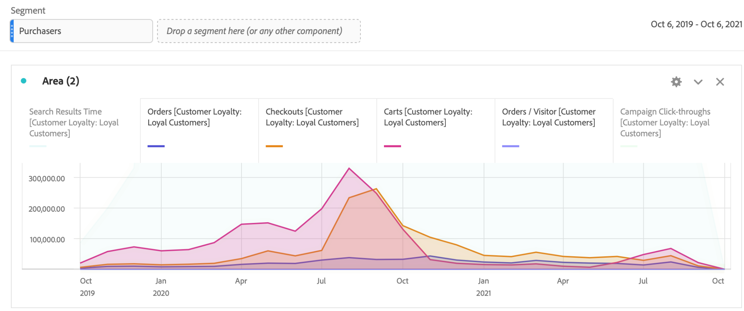
Notes:
The next metrics that we are analyzing is order, checkouts, carts, and order/visitor, by month as well. In each of these metrics, Loyal Customers are greater than New Customers. Meaning that Loyal Customers tend to put more in their cart than New Customers, and are buying more as well. Since we know that Loyal Customers tend to buy more and are continuously buying, in this scenario it is important to focus on how to get New and Returning Customers to a loyal customer status. Disney can do this by focusing on incentives for everytime they purchase, because once you convert them to Loyal Customers they will keep returning. It is also important to look at what time the customers tend to order/checkout most often. This is to then get an idea of when it is most important to push advertisements and get the word out. According to the data most customers tend to Order around August.

Slide 7
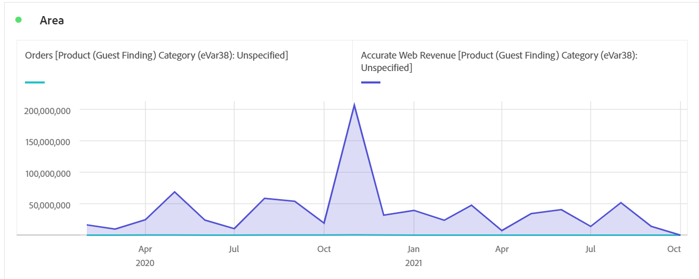
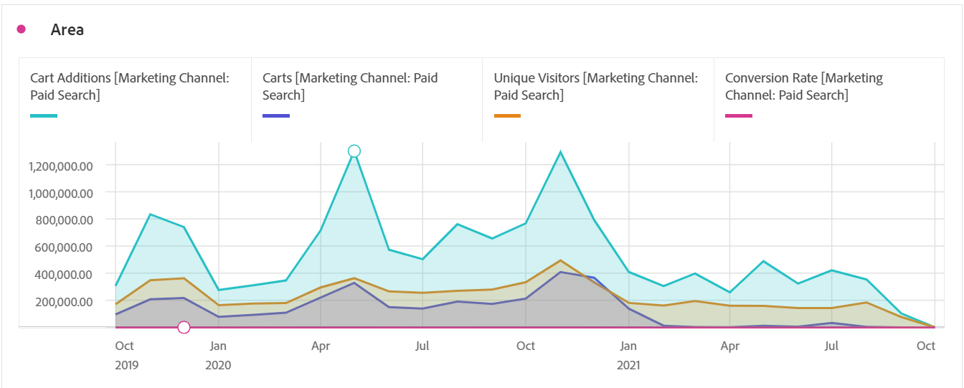
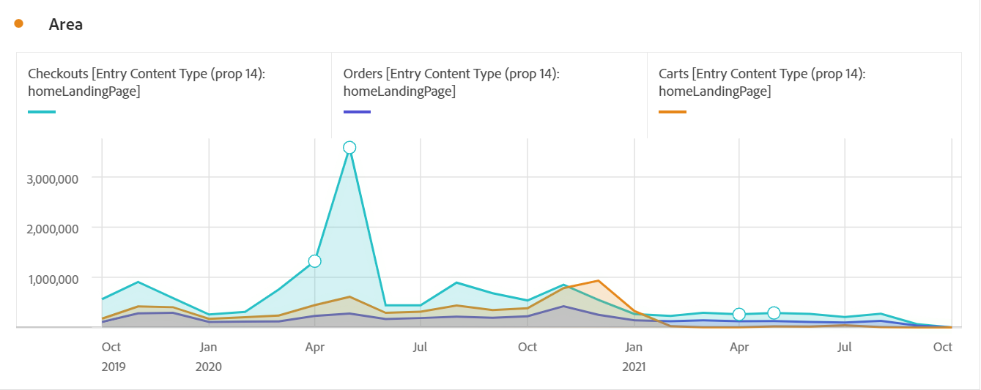
Cart Value Web
Notes:
For Web Data, we figured out average order value by taking the Web Revenue and dividing it by the Number of Orders. In order to understand Disney’s carts, we needed to analyze what the average order value of their carts could be between mobile and web sales. We first took an average of each months AOV. Then we calculated AOV for the period. Our calculations showed us an average order value for Disney Web was $343.23.
In the second graph we analyzed the purchaser segment using the metrics of carts, checkout, and orders to compare with Web and App revenue. You can see some similarities and correlation in the graphs trends by comparing the behavior of purchasers to average order value. Most of the Checkouts, Orders, and Carts had come from consumers who entered through the landing page.

Slide 8
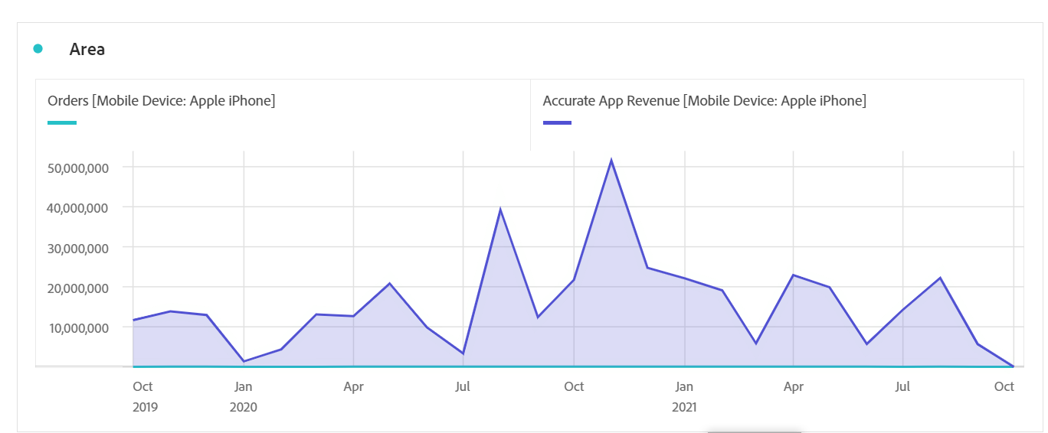
Cart Value App
Notes:
For App Data, we again figured out average order value for each month by taking the App Revenue and dividing it by the number of orders. We first found the AOV of each month for the period. Then we took an average for the entire period. Our calculations showed us an average order value for the app was $496.10 over the period which is higher than the average Web AOV.
To compare, we took the consumer segment and analyzed carts, cart additions, unique visitors, and conversion rates through marketing channels. Paid search had the highest amount of traffic and brought in the most revenue and success. Conversion rate is also a KPI of AOV.

Slide 9
Business Recommendations
Increase marketing campaigns before April and before October in order to trend upward with seasonality.
Focus on advertising different products as a whole to direct purchase paths.
Focus on incentives to entice new customers into loyal customers
Monopolize paid search power
Offer free shipping incentives for new customers to drive AOV.
Notes:
Based on our analysis of purchaser behavior, we recommend that Disney should increase their marketing campaigns before April and before October in order to trend upward with seasonality. Seasonality plays a key role in behaviors prior to purchase. The most profitable times for Disney fall between April and October which is directly influenced by the start of “summer vacations” as well as Halloween and all the subsequent holidays. Based on our data, by increasing campaigns prior to peak seasonality, it would help to ultimately drive revenue.
Based on our analysis of purchasing behavior through the Disney App across different types of Customers, we came to the conclusion that Disney should focus on advertising and adding incentives to entice new customers. These two recommendations came about from the data that we collected when comparing Customer search times, orders, carts, and order/visitor metrics. When looking at Search Times we found that Loyal Customers tend to have a lower search time than New/Returning customers. This would indicate that Loyal Customers know exactly what they want as opposed to New/Returning Customers. From this finding we realized that if Disney had more advertisements either on their website or on social media, than new customers would click on the product they like and lower their search time, which can increase their purchase amount.
We also found that by comparing Customer Loyalty orders by month, that the best time to advertise would be March or June, which is right before peak season. It is important to continue to advertise during off ordering season because you want to stay top-of-mind among your customers. Lastly, looking at all the metrics as a whole, we came to the conclusion that once you get a customer, you will keep the customer. Loyal Customers tend to buy more and more often, so in order to gain more loyal customers, Disney should focus their efforts on incentives to keep the customers coming which then turn them into Loyal Customers. For example, incentives such as discounts or free items. These incentives will also be important when Disney has the least amount of purchases for that month, because if customers buy at the lowest times than they are likely to buy at the highest times.
Paid search is the most successful marketing channel that Disney has, as such, they should use this to monopolize on their marketing power to bring in more traffic through paid search that takes consumers to the landing page. Paid search to landing page path gave Disney the most consumer traffic. In order to increase average order value when looking at carts on both web and mobile, there are a few ways to approach.
We suggest that Disney should monopolize on the power their paid searches bring to their homepage as well as driving up order value by offering free shipping for their new customers in order to increase retention into returning or loyal customers. In a tiered system, each time a customer comes back to purchase, the free shipping incentive goes up until they turn into a loyal customer. For example, a first time customer gets free shipping on any order amount. The next time they come back to purchase, they get free shipping on $50 or more, and then the third time they come back to purchase after that, they get free shipping on $100 or more, etc. This would cease after turning into a loyal customer, but offering the incentive a few times would increase average order value and consumer retention. By also offering something like free-shipping it would also increase the conversion rate of consumer purchases.

Slide 10
Thank You

